Slide 1
Project Time Management System
By: Mohammad Alasmary, Kelly Goodman, Kevin Holligan, Elizabeth Lor

Slide 2
Project Summary
A web-based application that tracks the hours employees work on specific projects.
This is an organizational project tracker that is tailored for project contributors to be able to manage their individual time.
It additionally sums contributor hours to allow project managers to manage human resources

Slide 3
Use Case #1: Create Project
Allows project owners to create new projects in the system
The system will prompt the user with a web form to define the project attributes (e.g. Project Name, Deadline, Description, etc.)
The system will generate a new project with the define attributes and add it to the system project database
It will then be displayed on the list of the user’s projects

Slide 4
Use Case #2: Modify Project
Allows the owner of a given project to modify details (e.g. Project Name, Deadline, Description, etc.) or add users
The system will change the attributes of the given project in the project database
The updated information will then be displayed on the list of the user’s projects

Slide 5
DEMO

Slide 6
MVC Pattern
Model: interacts with the MySQL database
View: displays the data that model contains
Controller: controls the data flow into model objects and updates the view whenever data changes
Why MVC
the most quoted pattern in web programming
easy framework to use and learn
allows separate development of GUI view and business rules/logic on model

Slide 7
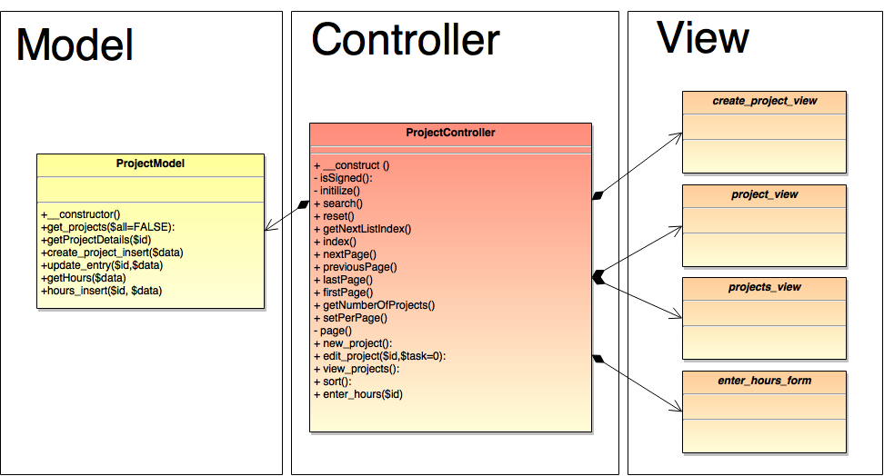

Slide 8
Design Pattern: Decorator
Decorator: extended behavior or functionality build upon some existing substructure
Why We Could Apply Decorator:
can be applied to all of the views
have a common interface, but being able to add objects to it
adding a table with list of projects
buttons to add/remove users
Notes:
Although we did not make use of any design patterns in the implementation of our final prototype, there were some design patterns that we could had applied. We can make use of the decorator design pattern for all of our views instead of using the framework views. There can be a common interface and objects can be add to it such has a table with a list of project or buttons to add/remove users.

Slide 9
Design Pattern: Iterator
Iterator: uniform way of traversing
Why We Could Apply Iterator:
going through a list of projects or users
being able to see the users based on a filter
being able to see the projects pertaining to the user
Notes:
With the iterator design pattern, we can apply it to our filters when searching for a user or a project. Every user has specific projects that they are working with; therefore an iterator can be use to go through the list of projects and display the projects that pertains to that specific user.

Slide 10
Design Pattern: Memento
Memento: a record of some object’s internal state, useful for future restoration
Why We Could Apply Memento
can look back at old projects - history of the projects
how many hours a user worked on the project
the list of users that worked on the project
type of tasks that the user did for the project
etc.
Notes:
We can also make use of the memento design pattern. Keeping track of previous information, the user can revert back to previous values or information if they happen to change their mind. For example, the user can change the number of hours they worked for a project back to the hours that was set before the value was changed.

Slide 11
Thanks

